Slide 1
Project Management Tools
Louis Smith
Connor Stewart
Fraser Stalker

Slide 2
What?
A project management tool allows for the simplification of completing a project while following a set schedule.
Project management tools can come in many forms:
Paper Based - Checklists, forms, templates
Automated - located on a local computer for primary users
Web based – the schedule is created and accessed through a web client

Slide 3
Why?
“A goal without a plan is just a wish.” ― Antoine de Saint-Exupéry
When working in groups it can be very easy to lose track of the common goal
Poor communication and organisation will always lead to failure.
Project management tools allow for:
Easy Collaboration
Improved Schedules
Progress Tracking
Improved Communication
Task Delegation

Slide 4





Tool | Advantages | Disadvantages
Microsoft Project | One time payment No Subscription needed Clear critical path | Very limited when compared to other tools Difficult to learn Only Compatible with Microsoft products
Teamwork | 20GB cloud based storage Free trail available | ~£55 per user No Integrated messenger
Zoho | 100GB Cloud based Storage Free trail available Integrated messenger Allows for task automation | £20 per user per month Additional features sold separately
Wrike | 50 GB Could based storage Free trail available Quick Set up | No integrated messenger Unintuitive interface £20 per user
Workfront | Easy to use Allows for allocation of roles Regularly updated Customizable API | No integrated messenger Not optimized for Gantt charts No internal timekeeping feature

Slide 5
Methods
Project management tools use a number of strategies to make management simpler. Today I will explain two of these in depth.
Gantt charts
PERT charts

Slide 6
Gantt Chart
A Gantt Chart is used to track tasks across time.
Designed by Henry Gantt in 1910
Considered the Industry standard
Shows in detail:
Phases
A List of Tasks
Milestones
Resources

Slide 7
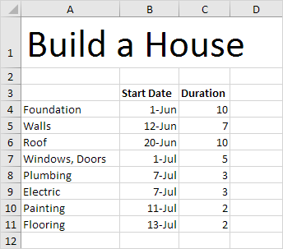
Example
(the duration of each task is in days)

Slide 8
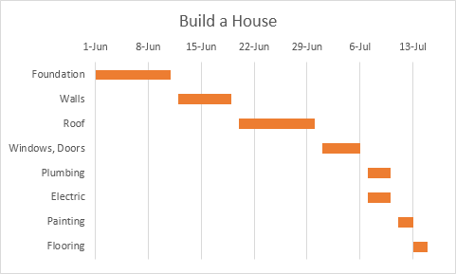
Notice how Plumbing work and Electrical work are executed simultaneously

Slide 9
PERT
A PERT chart is similar to a UML activity diagram
PERT = Program Evaluation Review Technique
Pert Charts typically include more detail as they often include the durations of tasks and show tasks that could be performed simultaneously.
Developed by the US Navy to coordinate missile development

Slide 10
Lets look at the same data from earlier…

Slide 11
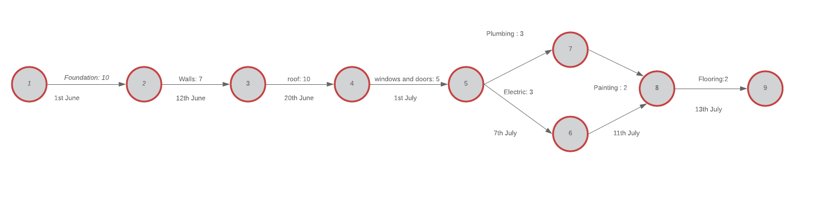
Here it is as a PERT chart!
Key:
Task: duration
Start Date

Slide 12
Lets look at how we can apply these tools to the case studies…

Slide 13
Gantt Chart Example: https://www.excel-easy.com/examples/gantt-chart.html
Comparison Data: http://www.pcmag.com/article2/0,2817,2380448,00.asp

